Slide 1
Problem & Data
Problem:
- Buyers: Overpaying.
- Sellers: Overpricing/underpricing.
Dataset:
- Kaggle (Nepali Housing Dataset).
- Key features: Price, Bedrooms, Location, Land Area.

Slide 2
Models Used
- Linear Regression: Price = m*X + b.
- Random Forest: Handles non-linearity, averages tree predictions.

Slide 3
Prediction Results
- Linear Regression: R² = 0.62, MAE = 0.60
- Random Forest: R² = 0.63, RMSE = 0.59
Better prediction with Random Forest.

Slide 4
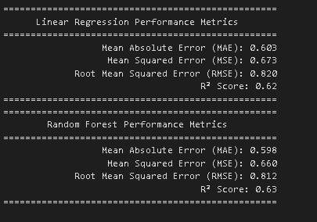
Prediction Results

Slide 5
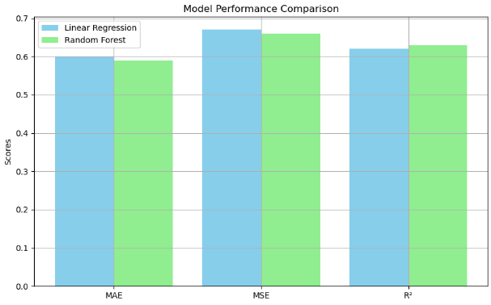
Model performance

Slide 6
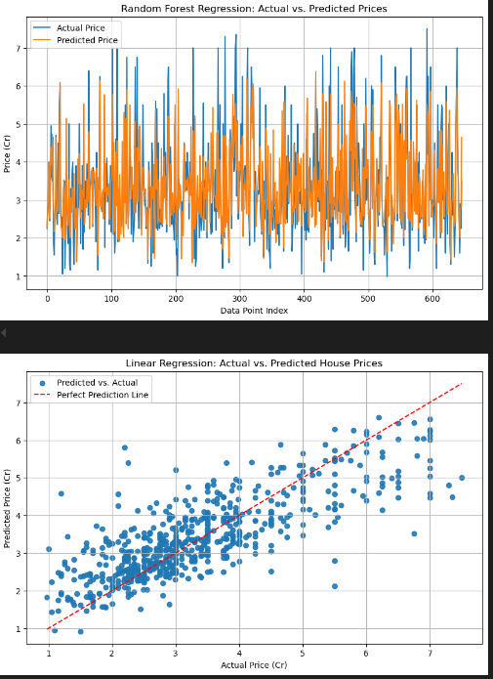
Model performance

Slide 7
Conclusion
- Accurate price predictions for buyers and sellers.
- Random Forest yields superior results.

